Slide 1
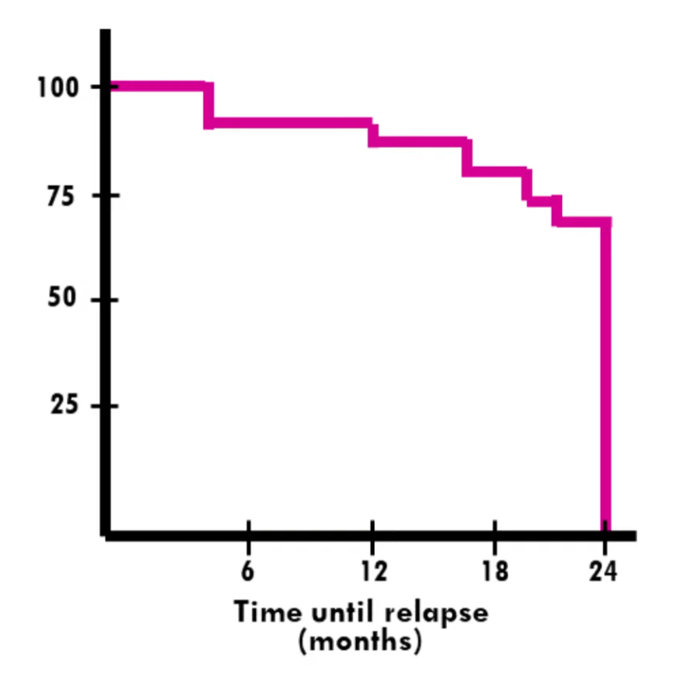
The Kaplan–Meier Curve plots survival rates over Time
Survival analysis is widely used to assess patient survival for specific diseases in medicine, to estimate the time until an insurance-related event in the insurance industry, and to evaluate the time until customer churn in retention analysis.

Slide 2
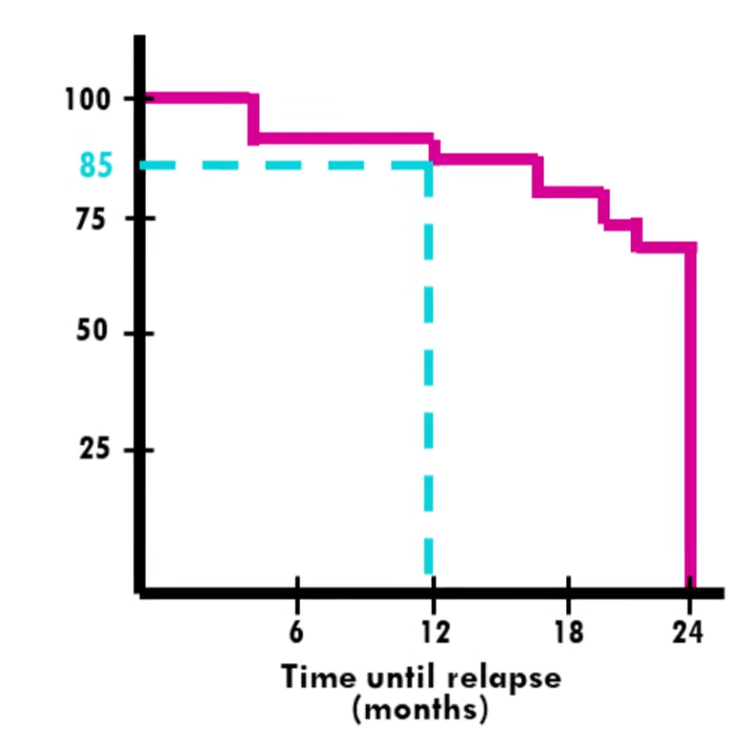
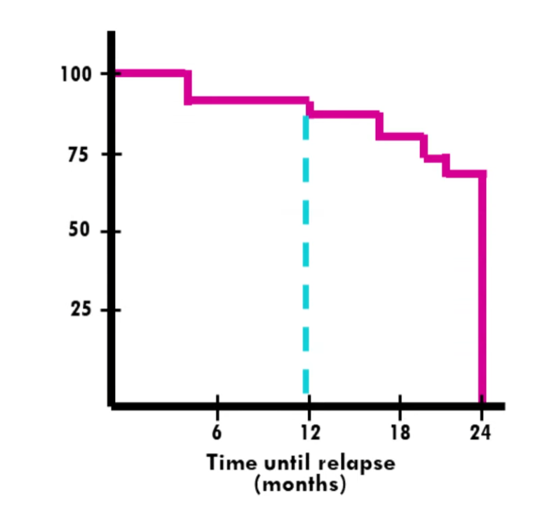
The Kaplan–Meier Curve plots survival rates over Time
Common example: What is the probability that a patient survives more then a year?
85 %

Slide 3
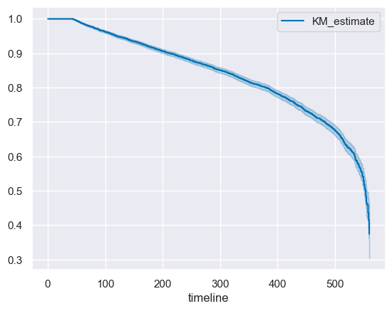
The Kaplan–Meier Curve estimated from our churn data
X axis reflects time pass since member signup date in days
Y axis reflects the probability of a member to stay engaged

Slide 4
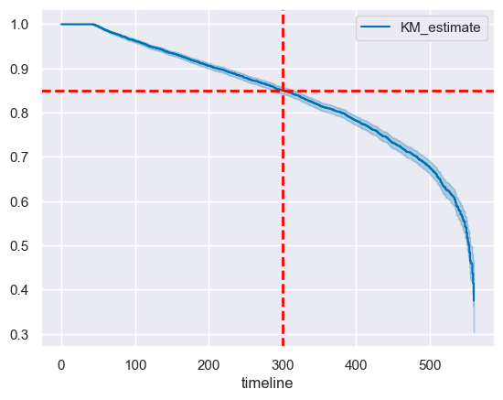
The Kaplan–Meier Curve estimated from churn data
For example: the probability of a member to stay engaged more then 300 days is 85%

Slide 5
Using the Kaplan–Meier estimator we can fit our Xi’s to predict the probability of a member to stay engaged at a certain time point and use this probability to rank the top n members for outreach.
The lower the probability is the higher rank the member gets.

Slide 6
Bonus :
Does outreach affect the member churn rate

Slide 7
The Kaplan–Meier Curve plots survival rates over Time
It is possible to build a curve that accounts for additional variables that may affect survival, so that more information can help us achieve more accurate prioritization
For example, in the graph on the left, we can see different curves reflecting various combinations of risk factors that affect survival
(* not from our data but from familiar diabetes dataset)

Slide 8
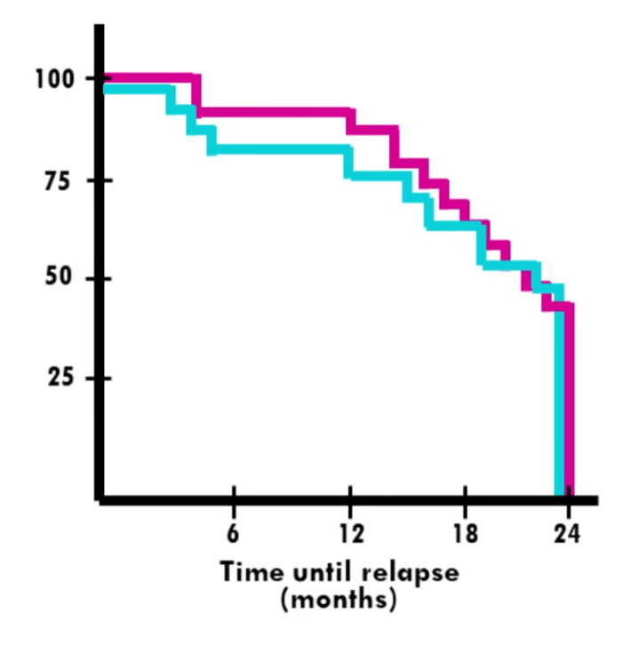
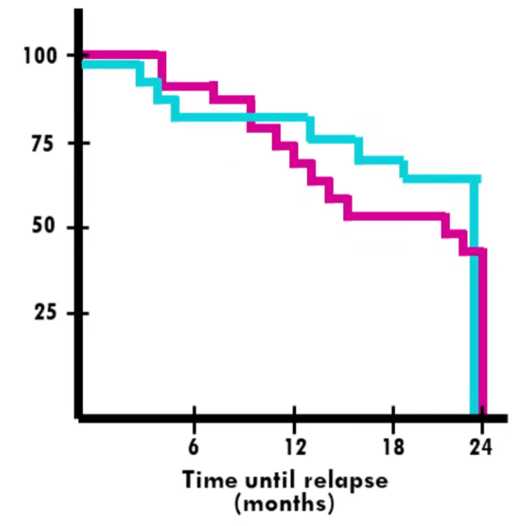
Multi-curve Kaplan–Meier survival curve
If the curves are parallel; it suggest that different groups has similar survival rates
If the curves diverge or cross; it indicates differences in survival rates between the groups

Slide 9
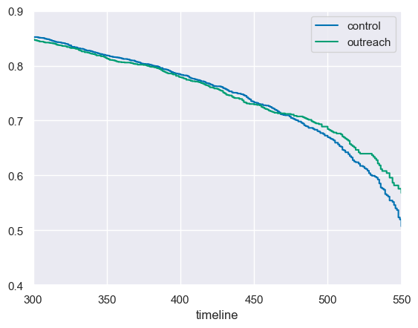
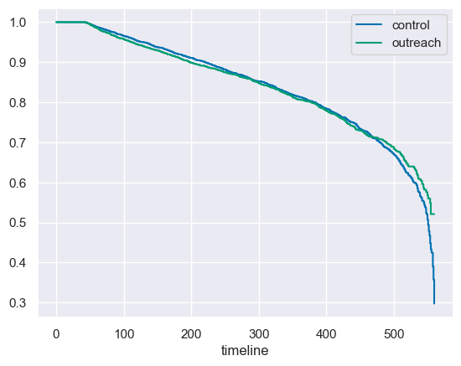
Multi-curve Kaplan–Meier of churn group vs control group
Zoom in
curves cross; it indicates differences in survival rates between the groups
Here we can see outreach improves the probability of a member to stay engaged

